Slide 1



The Aeolus Data Innovation and Science Cluster (DISC): Aeolus mission support from Launch to end-of-life and beyond
M. Rennie, 09:30: Aeolus impact on NWP
M. Porciani, 10:10: How Aeolus shaped Aeolus-2
B. Boyes, 10:30: Aeolus-2/EPS Aeolus Overview
T. Flament, 10:50: Scientific Activities regarding EPS-Aeolus
C. Lemmerz, 13:50: Aeolus Airborne Validation
B. Witschas (DLR), O. Reitebuch (DLR) and Tommaso Parrinello (ESA) on behalf of the Aeolus DISC
Workshop on Space-based Measurements of 3-Dimensional Winds
19 to 20 February 2025,NOAA Center for Weather and Climate Prediction (NCWCP), College Park, MD
Notes:
Herausforderung und Vorzüge dieser aktiven Fernerkundungsmissionen aufzeigen!

Slide 2
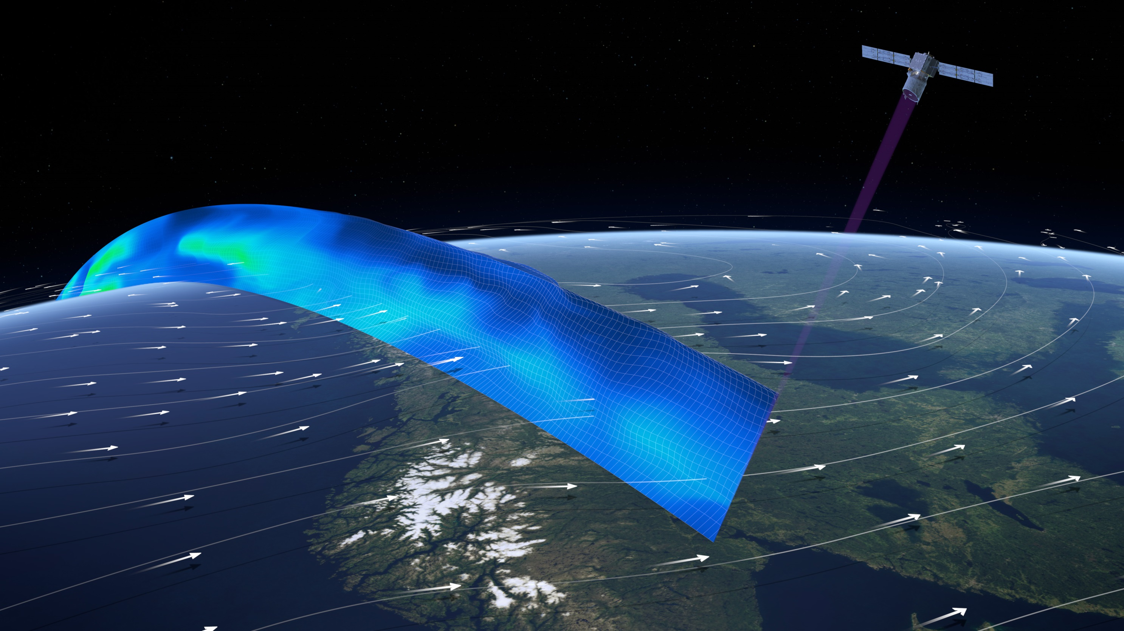
ESA’s Aeolus wind lidar mission (2018 - 2023)
Objective:
Improve numerical weather prediction (NWP) and advance understanding of atmospheric dynamics and climate processes
Orbit:
polar, sun-synchronous
7 day repeat cycle with 111 orbits ≈ 16 orbits / day
Geometry:
Altitude: 308 km
Angle: 35°
Vertical resolution:
Max. altitude: ≈ 30 km
Number of bins: 24
Bin thickness: 0.25 – 2 km
Operations
August 2018 to July 2023
Observations:
≈ 7000 line-of-sight (LOS) wind and aerosol/cloud optical profiles per day (≈ 5-6 times more than radiosondes)
Horizontal resolution:
Raw data: 3-4 km
Mie wind: 10-20 km
Rayleigh wind: 90 km
Wind requirements (HLOS)
Random error: 1 – 2.5 m/s
Systematic error: < 0.7 m/s
Credit: ESA/ATG medialab

Slide 3
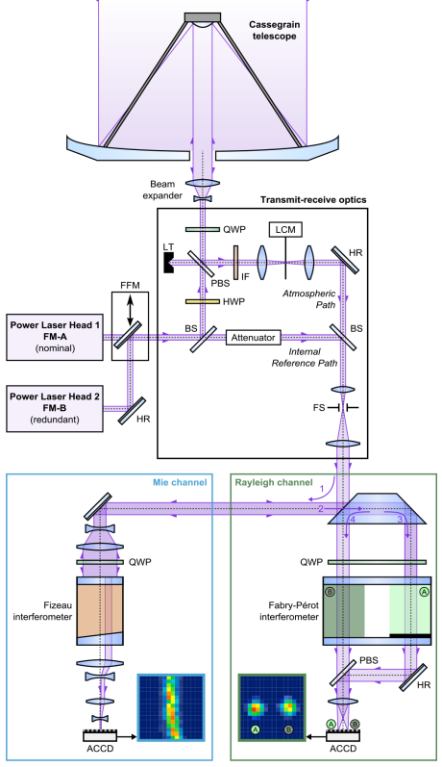
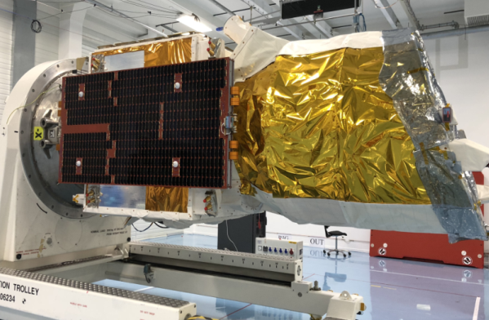
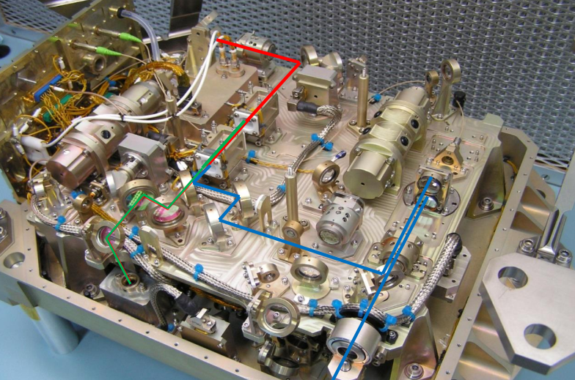
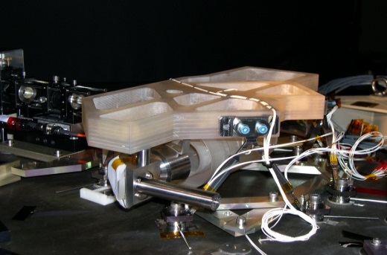
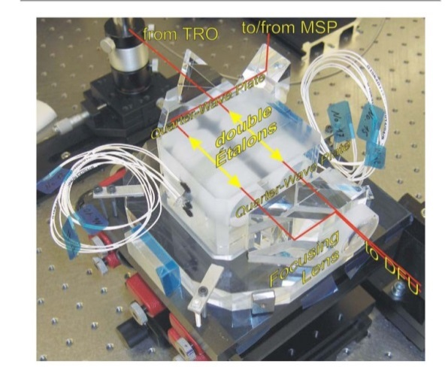
The ALADIN setup – a technological challenge
First European lidar in space after 20 years of development challenges
First wind lidar in space
First high-power, ultraviolet (UV) laser in space (@ 354.8 nm) with stringent requirements on frequency stability (< 10 MHz rms)
Challenging direct-detection approach, due to need for winds from broad-bandwidth molecular Rayleigh backscatter up to altitudes of 20-30 km
Sketch from Lux et al., 2021, AMT; credits of photographs: Airbus DS

Slide 4
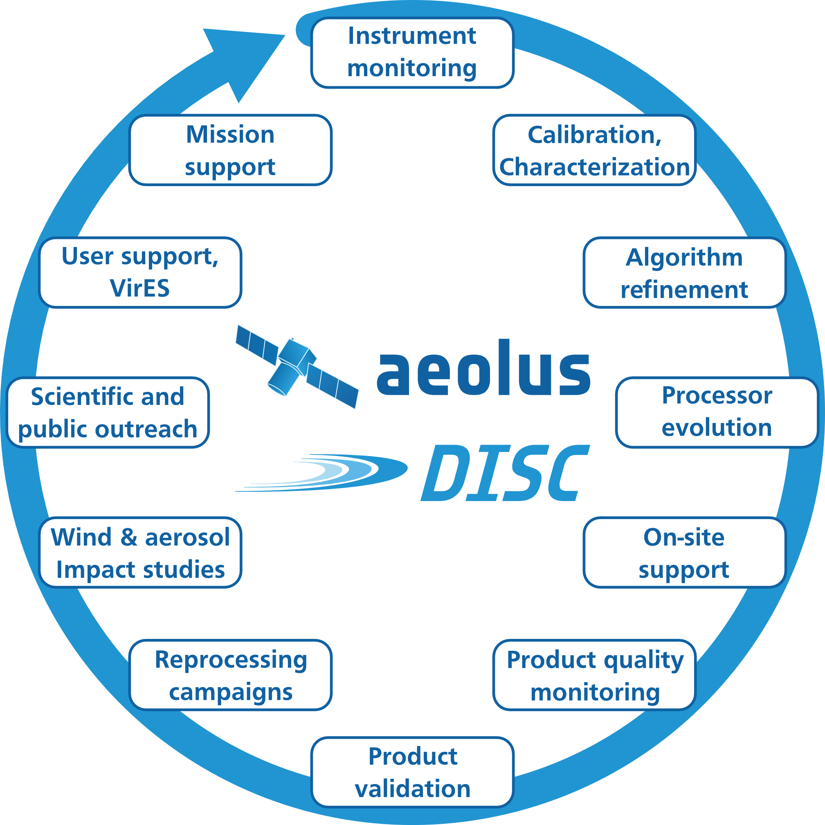
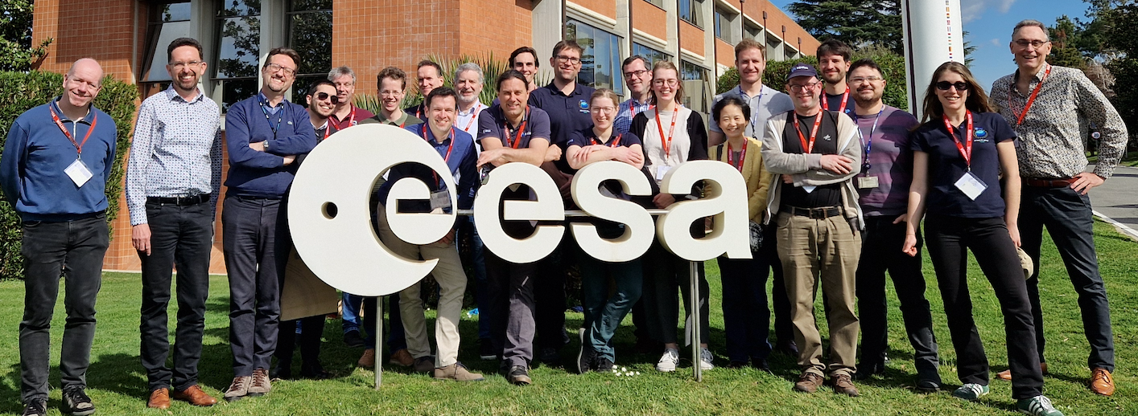
The Aeolus Data Innovation and Science Cluster - DISC
Oliver Reitebuch, Stefanie Knobloch, Christian Lemmerz, Oliver Lux, Uwe Marksteiner, Nafiseh Masoumzadeh, Fabian Weiler, Benjamin Witschas, Vittoria Cito
Filomarino, Isabell Krisch, Markus Meringer, Karsten Schmidt, Dorit Huber, Ines Nikolaus, Frédéric Fabre, Michael Vaughan, Katja Reissig, Alain Dabas, Thomas
Flament, Adrien Lacour, Jean-Francois Mahfouf, Ibrahim Seck, Saleh Abdalla, Lars Isaksen, Michael Rennie, Angela Benedetti, Will McLean, Karen Henry, Dave Donovan, Jos de Kloe, Gert-Jan Marseille, Ad Stoffelen, Ping Wang, Gerd-Jan van Zadelhoff, Diko Hemminga, Gaetan Perron, Sebastian Jupin-Langlois, Bas Pijnacker Hordijk, Filippo Tagliacarne, Marcella Veneziani, Simone Bucci, Giacomo Gostinicchi, Marco Galli, Massimo Cardaci, Sebastian Bley, Dimitri Trapon, Alexander Geiss, Thomas Kanitz, Anne-Grete Straume, Eliana Barbera, Denny Wernham, Trismono Krisna, Jonas von Bismarck, Massimo Romanazzo, Stefano Aprile, Timon Hummel and Tommaso Parrinello.
DISC was kicked-off 2019 (until 2028) with teams cooperating since 2003 and funded by ESA
14 international partners with ≈40 scientists and engineers coordinated by DLR
Broad range of experts and strong links to all ESA entities, space industry and science community
DISC Meeting at ESRIN in Frascati March 2024

Slide 5
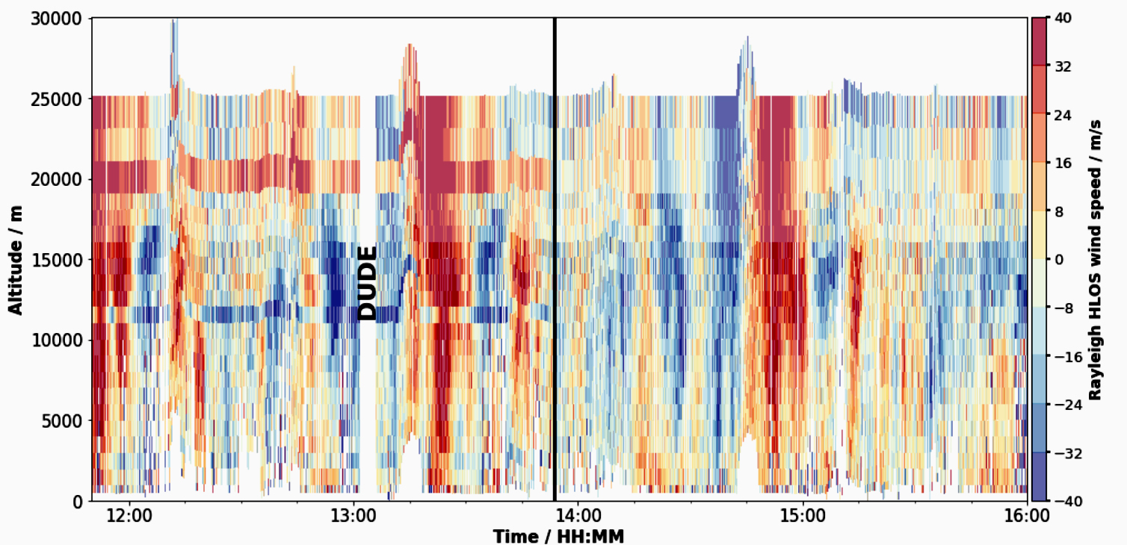
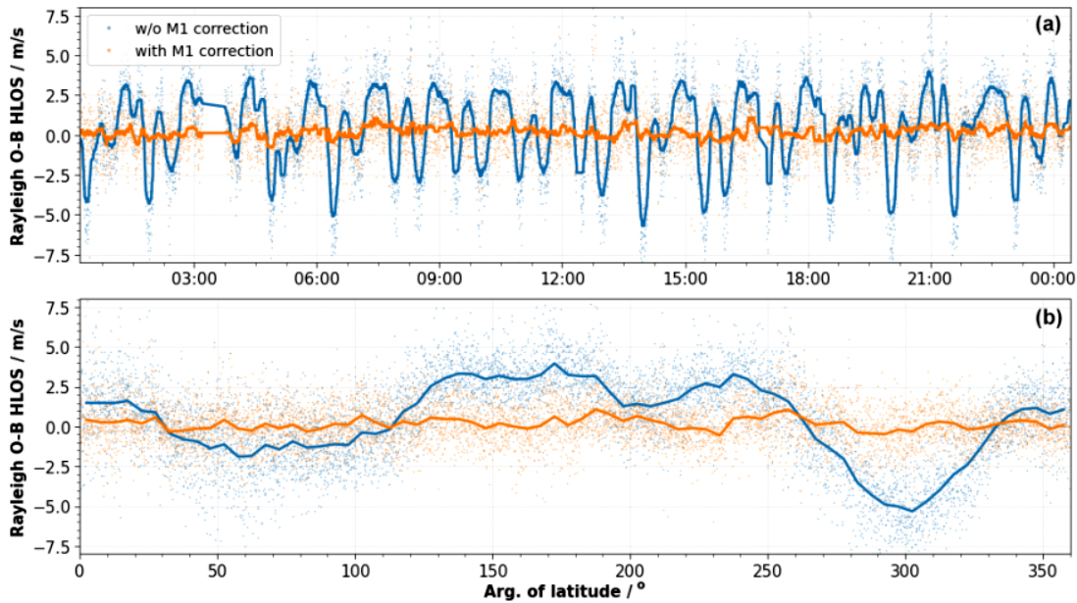
Investigating and correcting “unexpected” bias sources Hot pixels and telescope temperature variations
Hot pixels
Telescope temperature variations
Enhanced dark current rates on hot pixels of the CCD detector lead to biases of up to several m/s.
M1 telescope mirror T-variations (mean + gradient along the mirror) lead to orbit-dependent biases of several m/s (for both Mie and Rayleigh).
→ Corrected with special instrument operation mode DUDE (Down Under Dark Experiment, 4 to 8 per day) and on-ground correction in L1B processor since 14 June 2019
→ Corrected using correlation between M1 temperatures and ECMWF model bias (O-B) every 12/24h; implemented since 20 April 2020 (using ground-return correction works with 10% lower performance).
Weiler et al., AMT, 2021: “Characterization of dark current signal measurements of the ACCDs used on board the Aeolus satellite”.
Weiler et al., AMT, 2021: “Correction of wind bias for the lidar on board Aeolus using telescope temperatures”.
Notes:
Hot Pixels: Already shortly after the successful launch of the European Space Agency satellite Aeolus in August 2018, it turned out that dark current signal anomalies of single pixels (so-called “hot pixels”) on the Accumulation-Charge-Coupled Devices (ACCDs) of the Aeolus detectors detrimentally impact the quality of the aerosol and wind products potentially leading to wind errors of up to 4 m/s.
DUDE: To allow dark signal characterization of the memory zone during continuous laser operation, the so-called DUDE (Down Under Dark Experiment)-measurement procedure was developed. During DUDE measurements, the range gate timing settings are adjusted such that the theoretical return signal is acquired from below the Earth’s surface. In that way, dark current signals of all pixels of the memory zone can be measured without lidar signal contributions apart from the solar background signal.
M1 correction: One systematic error source was determined to be related to small fluctuations of the temperatures across the 1.5 m diameter primary mirror of the telescope which cause varying wind biases along the orbit of up to 8 m s−1. It was shown that the telescope temperature variations along the orbit are due to changes in the top-of-atmosphere reflected shortwave and outgoing longwave radiation of the Earth and the related response of the telescope’s thermal control system.

Slide 6
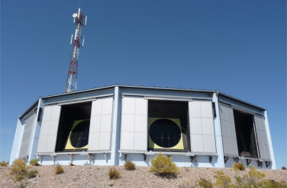
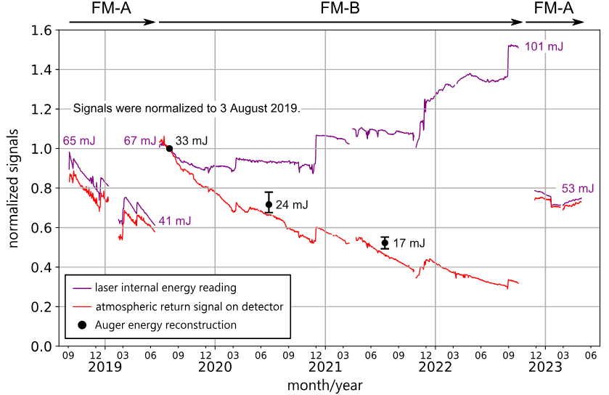
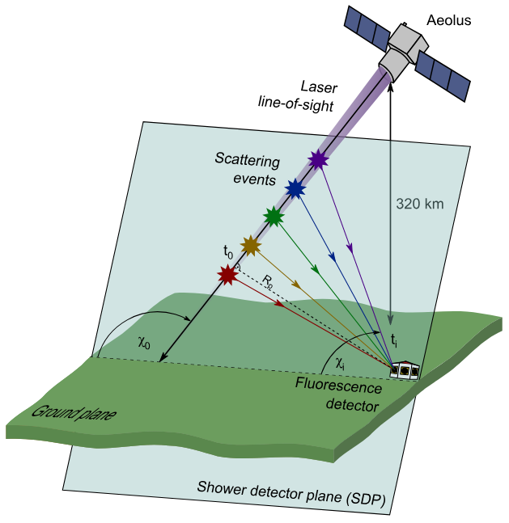
Laser energy performance characterization “Cosmology meets Earth Observation”
Cosmic rays are detected by secondary UV air showers in the atmosphere at the Pierre Auger Observatory (Argentina) → First measurements of a space-borne UV laser beam by an Earth-based cosmic particle observatory as support of the Aeolus mission:
Accurate determination of the laser beam ground track per shot (within 200 m)
Independent measurement of the emitted laser energy at the output of the telescope
Same approach is used now for EarthCARE
The reconstructed energies from the Pierre Auger Observatory allowed for an independent assessment of the ALADIN laser performance between 2019 and 2021 (FM-B laser).
The ATM signal (Ray) decreased by 70% within 3 years → loss on the emit-path (between laser & telescope) on optics unique to FM-B path (LIC/LID behind the laser as most probable causes).
UV laser energy was incrementally increased to >100 mJ to counteract the signal loss.
Pierre Auger Collaboration, et al., Optica, 2024: "Ground observations of a space laser for the assessment of its in-orbit performance”.
Lux et al., Appl. Opt., 2024: "Performance of the ultraviolet laser transmitter during ESA’s Doppler wind lidar mission Aeolus”.
Notes:
A few weeks before the first Auger measurement in August 2019, a switchover to the redundant FM-B laser was performed after the emitted energy of the nominal FM-A laser had decreased significantly from 65 to 41 mJ between December 2018 and May 2019 [16], as recorded by the monitoring photodiode located behind the laser transmitter. The Energy degradation was later traced back to a gradual misalignment of the master oscillator caused by a thermal drift of the laser bench, which resulted in a non-optimal temperature set point of the master oscillator depending on the emitted laser frequency
However, despite the stable laser energy, which was even increased to more than 100 mJ by several laser adjustments, the atmospheric signal levels decreased by more than 70% over the three years following the switchover, leading to a degrading precision of the Aeolus data with the random error of the Rayleigh wind results increasing from about 5 m/s to more than 8 m/s
The first Auger estimates in July/August 2021 strongly supported the root-cause analysis of the signal loss and ultimately led to the decision to switch back to the FM-A laser in November 2022. Despite the much lower output energy compared to FM-B at the end of its operation (101 mJ), the switchover to FM-A increased the atmospheric signal by a factor of 2.2, to a level corre- sponding to the laser energy of the first FM-A period in early 2019. The signal loss experienced during the FM-B period was thus fully recovered, confirming that it had occurred on the optics behind the laser output, more specifically on the optics that are unique to the FM-B, most likely within the relay optics, including the FFM, which guide the redundant FM-B laser beam onto the nominal optical path (see Fig. 1).

Slide 7
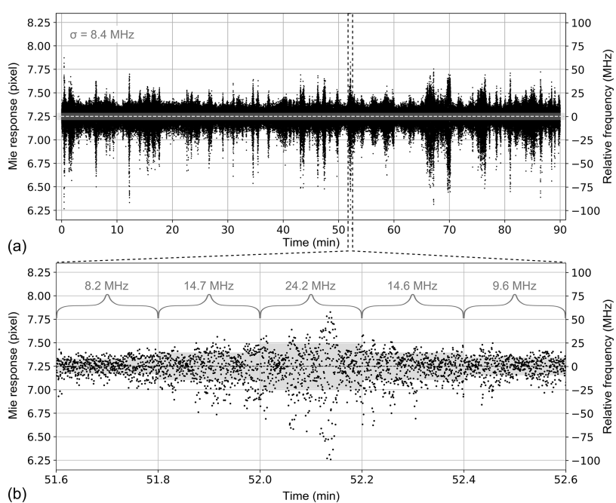
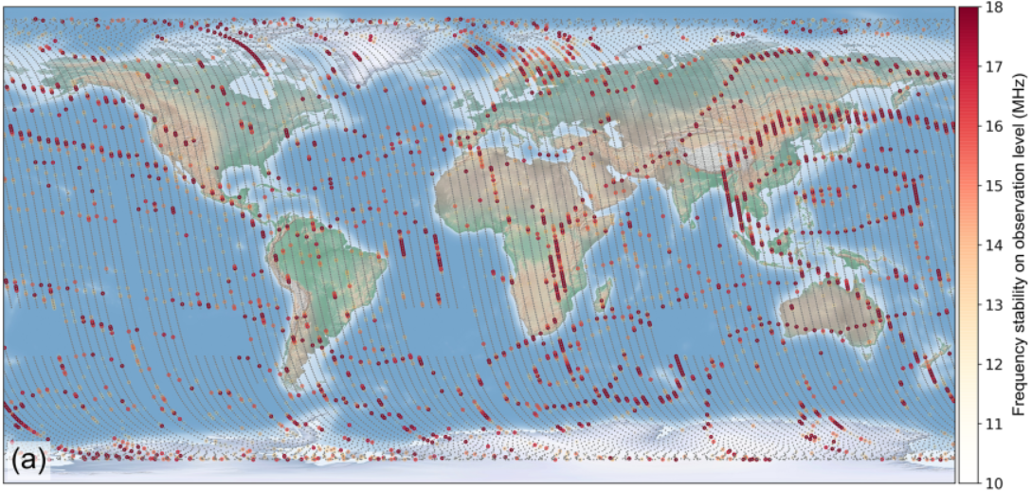
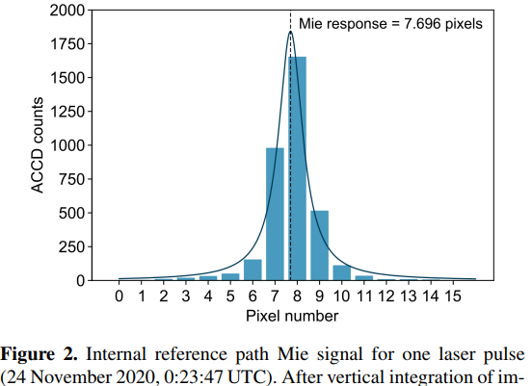
Laser frequency stability characterization
ALADIN as wavemeter
Laser frequency fluctuations along one orbit
Wind observations with enhanced frequency noise
The internal reference signal together with the Fizeau interferometer are used as a wavemeter → frequency stability from shot-to-shot
Dependency on geolocation → regions with critical rotation speeds of the satellite’s reaction wheels → micro-vibrations
Frequency stability is better than 10 MHz
Critical rotation speeds of the satellite’s reaction wheels led to enhanced noise of up to 150 MHz (pulse to pulse) and 30 MHz rms, with no obvious impact on the wind error (small percentage of wind measurements).
Lux et al. AMT, 2021: “ALADIN laser frequency stability and its impact on the Aeolus wind error”.
Notes:
Frequency measurements: Using the Fizeau interferometer as a wavemeter goes back to techniques developed with the A2D
Center Figure: Laser frequency fluctuations along one orbit (14 Oct. 2019 October 2019, 01:27 to 02:57 UTC). The underlying reason for the dependency on geolocation (as shown in the right figure) is the existence of critical rotation speeds of the satellite’s reaction wheels, which suggests that micro-vibrations are the root cause for the deterioration of the laser stability on timescales of a few tens of seconds.

Slide 8
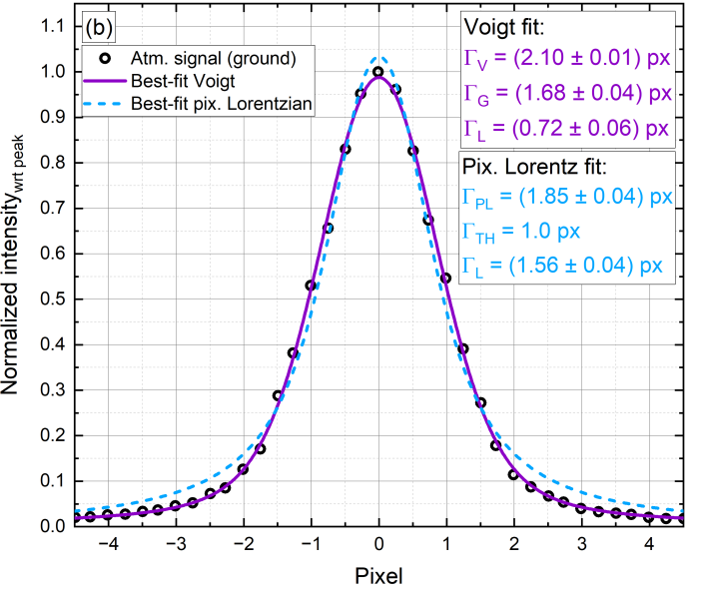
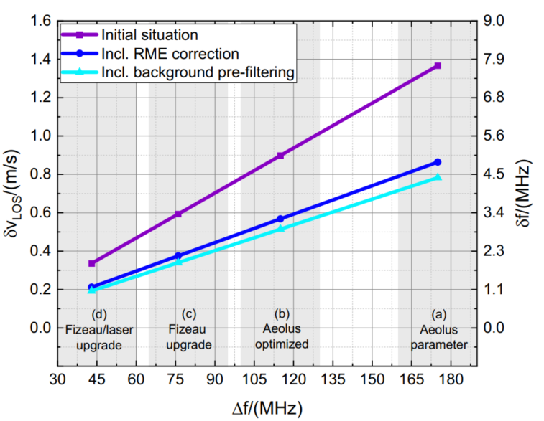
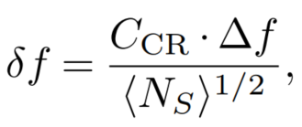
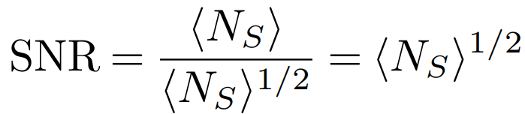
Instrument characterization and algorithm optimization Fizeau fringe analysis and spectral performance
Fizeau fringe analysis & algorithms
Fizeau spectral performance
The quantum limited accuracy δf for the Mie-channel is given by the Cramer-Rao lower bound (approx. for negligible background → only shot-noise of the signal):
Improvement by a factor of 6 possible
For a precise fringe measurement and charact-erization, a method for correcting the illumi-nation fct. was developed (fringe imaging).
Fringe follows a Voigt spectral shape (instead of Lorentzian) with a larger width of ~210 MHz (explained by laser pulse profile and off-axis illumination with a few 100 µrad)
∆f is the FWHM before detection
⟨N_{S}⟩ the mean number of electron-counts
C_{CR} is a constant ~ 1 (shape)
Improvement by a factor of 3 (with increased coverage)
A tool for calculating the quantum limited accuracy for the Aeolus Mie channel was developed, showing the possibility of improvements by a factor of 3 to 6.
Witschas et al., Appl. Opt., 2023: “Verification of different Fizeau fringe analysis algorithms based on airborne wind lidar data…”.
Wang et al., AMT, 2024: “Evaluation of Aeolus feature mask and particle extinction coefficient profile products using CALIPSO data”.
Vaughan et al., AMTD, 2024: “Spectral performance analysis of the Fizeau interferometer onboard ESA’s Aeolus wind lidar satellite”.
Notes:
The accurate fringe analysis was already performed based on A2D measurements.
∆f is the FWHM before detection
⟨N_{S}⟩ the mean number of electron-counts (radiometric gain = 0.684 LSB/ph.el.)
C_{CR} is a constant ~ 1 (shape factor)
The derivation of Eq. (9) was based on determining the median position of the fringe (i.e. with equal numbers of photodetections on either side). By doing so, the constant C was shown to be CL = π/4 ≈ 0.785 for a Lorentzian profile, and CG = [π/(16 · ln2)]1/2 ≈ 0.532 for a Gaussian profile [see also equations A94 and A95 in (Vaughan, 1989)].
EMSR = effective Mie spectrometer response
RME = radiometric efficiency (considering initial signal loss).

Slide 9
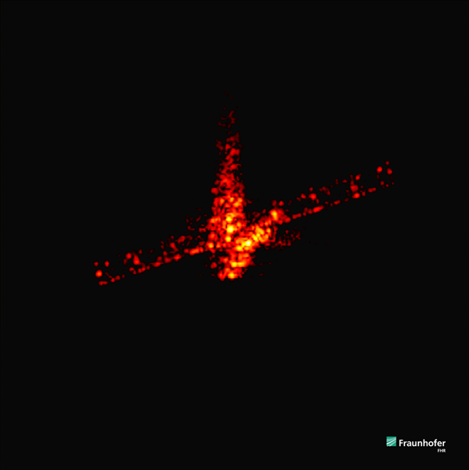
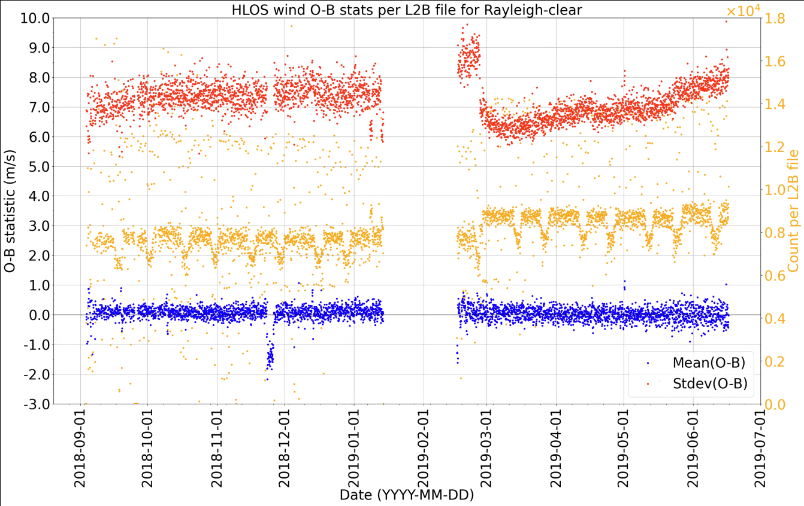
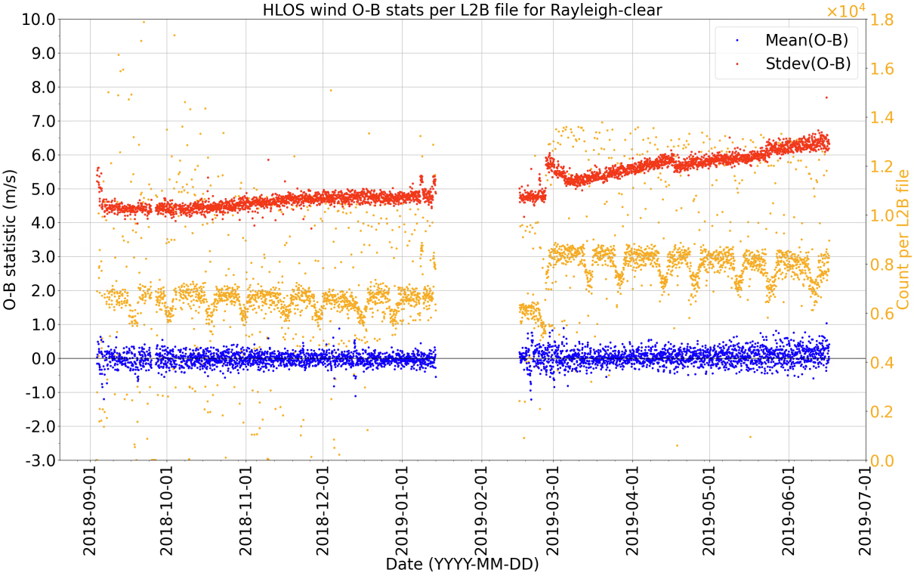
End of life and reprocessing Valuable work and the end and after the mission
End-of-life tests – a two-months test phase with Aeolus as space lidar lab
Data reprocessing (currently B16)
Rayleigh-clear winds
B14
B16
Last images of Aeolus
TIRA (tracking and imaging radar) with Ø34 m antenna
(Germany, 28 July 2023, 1 8:20 CEST)
1st FM-A
1st FM-A
Confirmation that hot pixels are radiation-induced (T-dependency obeys Arrhenius law), not clock-induced
Improving the laser frequency stability by ~factor of 2 due to an improved master oscillator cavity control setting, better compensating micro-vibrations
Operating UV laser with a record energy of 182 mJ
Increasing the internal reference signal stability by optimizing the laser chopper settings
… and many more
09/18
11/18
01/19
09/18
11/18
01/19
Improvement of Ray.-clear random error by 20% to 30%
Improving calibrations and corrections (hot pixel)
Improving the estimated error assessment which results in better quality control
Updating algorithms (e.g., Voigt instead of Lorentzian for Mie channel data)
…and many more
Notes:
ATLID Test can be mentioned as addidional on.

Slide 10
Summary The 7 major challenges and achievements of Aeolus
1st European lidar and 1st wind lidar in space in operation for 4 years and 10 months (from Aug 2018 until July 2023); lifetime objective (3.5 years) achieved and demonstration of wind lidar technology in space.
1st successful demonstration of operation of a UV laser in space with stable performance of both lasers (end of life of Aeolus was not determined by the instrument, but by the satellite fuel and solar activity).
1st demonstration of positive impact of wind profiles for numerical weather prediction with even operational use for daily forecasts since January 2020: ECMWF, DWD, Météo-France, UK Met Office and NCMRWF.
Demonstration of high-spectral resolution lidar for retrieval of aerosol extinction in orbit → demonstrated potential also for enhanced aerosol capabilities for EarthCARE with depolarization channel.
1st ESA Mission with an assisted re-entry on 28 July 2023, although not being designed for it.
Aeolus succeeded in becoming an operational, meteorological follow-on program with the decision on ESA´s Ministerial Meeting in November 2022, socio-economic study from EUMETSAT indicates benefit-cost ratio for EPS-Aeolus of factor 20 and factor 33 adding EPS-Sterna.
Aeolus paved the way for the future European lidar missions (EarthCARE, Merlin) and EPS-Aeolus wrt. technology, framework and cooperation of ESA, industry, DISC, NWP, Cal/Val, science community.

Slide 11
Backup

Slide 12
Relevant references
Lux, O., Lemmerz, C., Weiler, F., Kanitz, T., Wernham, D., Rodrigues, G., Hyslop, A., Lecrenier, O., McGoldrick, P., Fabre, F., Bravetti, P., Parrinello, T., and Reitebuch, O.: ALADIN laser frequency stability and its impact on the Aeolus wind error, Atmos. Meas. Tech., pp. 1–40, 2021.
Lux, O., Reichert, R., Lemmerz, C., Masoumzadeh, N., Wernham, D., Candra Krisna, T., Marchais, D., Bell, R., Parrinello, T., and Reitebuch, O.: CCD detector performance of the space-borne Doppler wind lidar ALADIN during the Aeolus mission, Appl. Opt., 63, 6754–6775, 2024.
Pierre Auger Collaboration, et al. "Ground observations of a space laser for the assessment of its in-orbit performance." Optica 11.2 (2024): 263-272.
Wang, P., Donovan, D. P., van Zadelhoff, G. J., de Kloe, J., Huber, D., & Reissig, K.: Evaluation of Aeolus feature mask and particle extinction coefficient profile products using CALIPSO data, AMT, 17(19), 5935-5955, 2024.
Rennie, M. P., Isaksen, L., Weiler, F., de Kloe, J., Kanitz, T., and Reitebuch, O.: The impact of Aeolus wind retrievals on ECMWF global weather forecasts, Quarterly Journal of the Royal Meteorological Society, n/a, https://doi.org/https://doi.org/10.1002/qj.4142, 2021
Vaughan, M., Ridley, K., Witschas, B., Lux, O. Nikolaus, I. and Reitebuch, O.: Spectral performance analysis of the Fizeau interferometer onboard ESA’s Aeolus wind lidar satellite, AMTD, 2024.
Weiler, F., Kanitz, T., Wernham, D., Rennie, M., Huber, D., Schillinger, M., Saint-Pe, O., Bell, R., Parrinello, T., and Reitebuch, O.: Characterization of dark current signal measurements of the ACCDs used on board the Aeolus satellite, AMT, 14, 5153–5177, https://doi.org/10.5194/amt-14-5153-2021, 2021.
Weiler, F., Rennie, M., Kanitz, T., Isaksen, L., Checa, E., de Kloe, J., Okunde, N., and Reitebuch, O.: Correction of wind bias for the lidar on board Aeolus using telescope temperatures, Atmos. Meas. Tech., 14, 7167–7185, https://doi.org/10.5194/amt-14-7167-2021, 2021b.
Witschas, B., Lemmerz, C., Lux, O., Marksteiner, U., Reitebuch, O., Weiler, F., Fabre, F., Dabas, A., Flament, T., Huber, D., and Vaughan, M.: Spectral performance analysis of the Aeolus Fabry–Pérot and Fizeau interferometers during the first years of operation, AMT, 15, 1465–1489, https://doi.org/10.5194/amt-15-1465-2022.
Witschas, B., Vaughan, M., Lux, O., Lemmerz, C., Nikolaus, I., and Reitebuch, O.: Verification of different Fizeau fringe analysis algorithms based on airborne wind lidar data in support of ESA’s Aeolus mission, Appl. Opt., 62, 7917–7930, https://doi.org/10.1364/AO.502955, 2023b.

Slide 13
Major Lessons Learnt
Winds were / are / and will be important for improving weather forecasts => Aeolus-2 / EPS-Aeolus.
Doppler lidar technology as pioneered on Aeolus proved to provide wind profiles from ground up to 25 km, but significant improvements are needed to fulfill NWP requirements in the 2030s timeframe:
Higher vertical range up to 30 km and capability up to 40 km (=> detector)
Higher vertical and horizontal resolution (SNR, detector)
meeting Aeolus random error requirements (2.5 m/s HLOS)
Factor 4 improvements in signal levels needed compared to Aeolus in-orbit performance.
UV laser operated in space, despite LIC/LID => O₂ cleaning (ALADIN) or pressurized laser housing (ATLID); higher laser energy and higher efficiency needed
SiC telescope with Ø1.5 m: thermal-optical stability along the orbit was not sufficient, although thermally stabilized:=> de-focus, signal loss, and wind bias => trade-off mass/thermal inertia; thermal-control.
On-ground end-to-end performance verification in TVac was (too) limited and missed important issue with radiometric budget: initial signal loss of Aeolus.
CCD-detector technology: issue with radiation-induced hot-pixels; missed with standard radiation test procedures on-ground.
Airborne demonstrator for the space-borne instrument was a key asset for prep. and Cal/Val.

